Slide 1
CANADIAN NATIONAL MASTER
CKC SENIOR HUNT TESTS
2018
(Short Version)
Notes:
Sources For Good Information on Judging, Field Work and Setting up Good Tests
(Copy links into your browser)
Retriever Field Trial Judging – A Manual - “The Blue Book” Aimed at field trial judges but carries a large amount of information that would translate well to hunt tests and WC/I/X work
https://www.theretrievernews.com/store/p7/Judge%27s_Manual_%28Digital_eBook_Edition%29.html
Retrievers ONLINE - Dennis Voigt has published many outstanding articles on judging in his Retrievers ONLINE magazine and currently appear on his blog.
http://www.retrieversonline.com/
Retriever Field Trial Judging Fundamental and Checklist
http://cdn.agilitycms.com/retrievers-online/AMJ_2012_Judging%20Checklist-hi%20res.pdf
Retriever News
https://www.theretrievernews.com/
CKC Rules and Regulations
https://www.ckc.ca/en/Files/Forms/Shows-Trials/Event-Rules-Regulations/Hunt-Test-Rules-and-Regulations-for-Retrievers-Bar
It is easy to set up tests that eliminate dogs - all dogs can be tricked – but that is not the role of a judge. Judges should be on the dog’s side when judging – not to give it an easy pass – but to bring out the best that dog has to offer on that day.

Slide 2
Table of Contents
TOPIC | SLIDE
Purpose of CKC Hunt Tests | 3
Key Hunt Test Definitions | 4 - 6
Senior Test Requirements | 7
Senior Test Design Considerations | 8 - 11
Evaluating the Senior Dog General Talking to the Dog Recasting the Dog Handling on Marks Steadiness Interference Switching Lining the Dog Upland Hard Mouth Sample Senior Score Sheets | 12 - 28

Slide 3
Purpose of CKC Hunt Tests
The purpose of the hunt test for Retrievers, Barbet, Irish Water Spaniels and Standard Poodles is to test the merits of, and evaluate the abilities of these dogs in the field in order to determine their suitability and ability as hunting companions
Hunt tests should, therefore, simulate as nearly as possible the conditions met in a true hunting situation
- Section 13.1.1 of CKC Rules and Regulations
The purpose of the Senior Hunt Test is (also) to encourage owners to train in advanced work
- Section 11.2.1 (b) of CKC Rules and Regulations

Slide 4
Key Hunt Test Definitions
Break
Dog leaves to retrieve without release by handler and is not brought under control
Controlled Break
Dog leaves to retrieve without release by handler but is quickly brought under control verbally or by whistle and returns
In Master, a controlled break calls for a “0” score except in the Upland series where it is considered a minor fault when the dog is brought under immediate control
Creeping
Leaving the handler on a tentative yet excited basis, short of leaving completely
General unsteadiness
Can be a safety issue
Notes:
Break
A break occurs when a dog makes a movement which, in the opinion of the judges, indicates a deliberate intent to retrieve without having been ordered to do so, and cannot be brought under control by the handler
Controlled break
Controlled break is when a dog leaves before being sent but is quickly brought under control by verbal command or whistle and returns to the handler
Discussion should take place at this time on controlled breaks. Controlled break can also occur when the dog stops on its own without handler communicating verbally. If the dog is watching the marks, leaves the handler’s side stops a few feet or more without handler saying sit of whistling, this is a controlled break. Controlled breaks are only while marks are going down or in Master on the sit to flush.
Creeping
Creeping is considered as leaving the handler on a tentative yet excited basis, short of leaving completely to retrieve the bird, or waiting to be sent to retrieve. General unsteadiness short of breaking:
Creeping can be a safety issue in a real hunting situation.
As a guide in their instructions to participants, judges may wish to use a hypothetical creep line of “no creeping beyond the end of the gun barrel”.

Slide 5
Key Hunt Test Definitions Cont’d
Pop
A pop, or popping, is voluntary stopping (without command) and looking back to the handler for direction after having been sent
Diversion Bird
A bird that is thrown and acts to divert the dog from their task at hand as it occurs
Occurs while the dog is actively working in the field as opposed to being at the line
Poison Bird
A poison bird is a mark, seen from the line, that is left in the field while the dog picks up a blind
If the judge chooses to have the poison bird picked up after delivery of the blind, it will be judged as a mark
Notes:
Popping
Popping is characterized as a voluntary stopping (without command) and looking back to the handler for direction.
Discussion could take place at this point with regards to whether a pop also constitutes a dog running/moving forward but glances back.

Slide 6
Key Hunt Test Definitions Cont’d
Recast
Distance for an allowable recast should be agreed upon by judges but is usually limited to 15 feet or 4.5 meters
Usually attributed to a dog’s confusion as to whether it was sent
It is not considered a recast when a dog goes to the area of the fall, fails to find the bird and returns (or is recalled)
This must be evaluated as a lack of perseverance
Refusal
Refusal is a disregard of a command
Failure to stop and look at the handler when signalled or failure to continue in new direction for a considerable distance both constitute a refusal
Not coming when called is as bad as not going when sent
Notes:
Recast
Distance should be agreed upon by judges but is usually limited to 15 feet or 4.5 meters……
Discussion could take place with regards to some of the grey areas around recasts and no-gos. Did the dog hear the handler? How should the dog be evaluated?
Refusal
Refusal is disregard of a command. Failure to stop and look to the handler when signalled, failure to continue in that new direction for a “considerable” distance constitutes refusal. Not coming when called is as bad as not going when sent.
Discussion could take place at this point with regards to what is considered as a “considerable” distance – 3 feet, 5 feet, 10 feet?

Slide 7
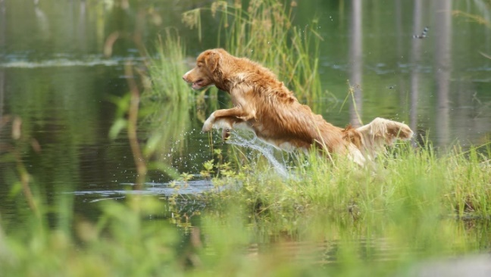
Senior Test Requirements
A minimum of 5 hunting situations shall be tested as follows:
One land blind
One water blind
One set of double land marks
One set of double water marks
An Upland hunting test
Each of these hunting situations can be considered a “series”
Notes:
The blinds may be run as a double blind, one placed on land and one placed on water.
In the Upland potion of the test, the dog may be urged to hunt or handled to maintain his range and position. The bird(s) must be placed in cover within the test area. When located, the birds must be retrieved by the dog to the handler. Dead birds shall be used.
- 9.2.1(e)

Slide 8
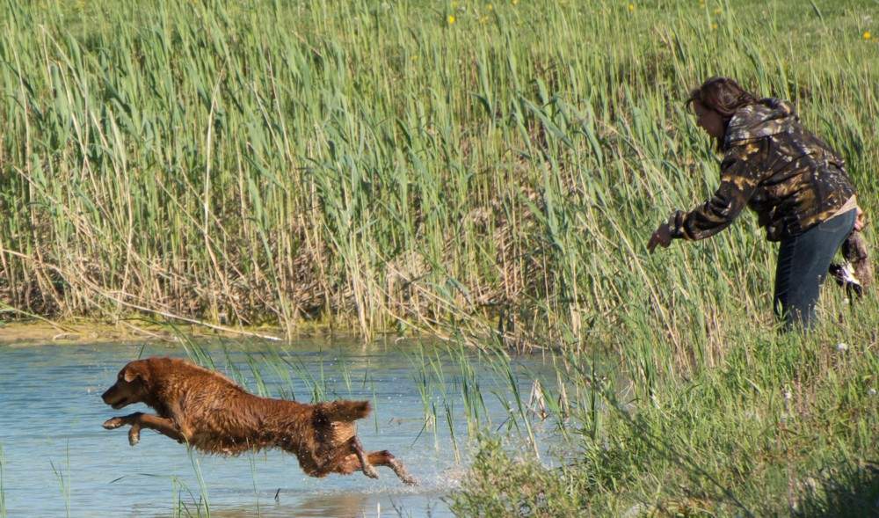
Senior Test Design Considerations
No marked retrieve shall normally exceed 73.1m (80 yards) and no mark should be thrown inside of 20 yards
There shall NOT be any walk-up test in Senior
Each dog must honour a working dog at least once
On the honour, the honour dog must be placed so that it is unlikely the working dog will cross in front of it
Diversion shot(s) shall be used, but diversion birds shall NOT be used
Notes:
Discussion can take place on what diversion shots/birds are and why they are part of the tests. Also, why diversion shots can be used at Senior but not diversion birds.
Diversions
A diversion bird is thrown while the dog is out actively working in the field, not on the line. It diverts the dog from their task at hand as the task occurs.
A poison bird is a mark as it is marked from the line. The term poison bird is used to describe the concept of leaving the mark in the field while picking up a blind.

Slide 9
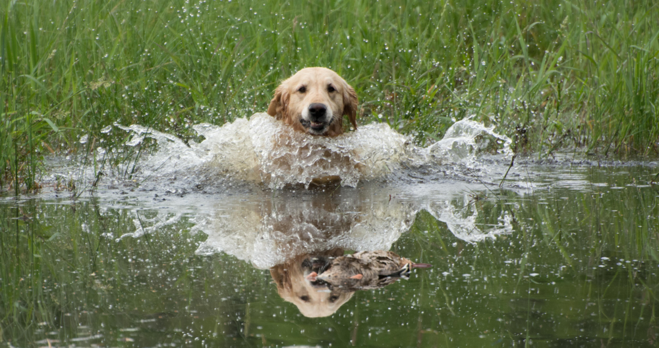
Senior Test Design Considerations: Cont’d
As in Junior and Master, situations must simulate natural and realistic hunting situations
Test situations should make use of natural hazards, hunting equipment and obstacles encountered in hunting as much as is practicable
Visible gun stations should be kept to a minimum
Judges shall require the handler to shoulder or carry an empty shotgun or replica on at least TWO occasions
Safe gun handling is to be observed

Slide 10
Senior Test Design Considerations: Cont’d
Blinds
May be run as a double blind: one on land and one on water
Should be no longer than 73.1m (80 yards) and be as open as possible
Blinds should be run on grounds separate from marks
If not possible to use separate grounds for the blinds, judges MUST ensure previous marks do not influence or interfere with the blind
No blind is to be run between the marks
If the same piece of land or water is used for both blinds and marks, blinds MUST be run first
On water, shoreline blinds, heavy cover and re-entries are to be avoided
The line should be as close to the water as possible to avoid cheaty entries

Slide 11
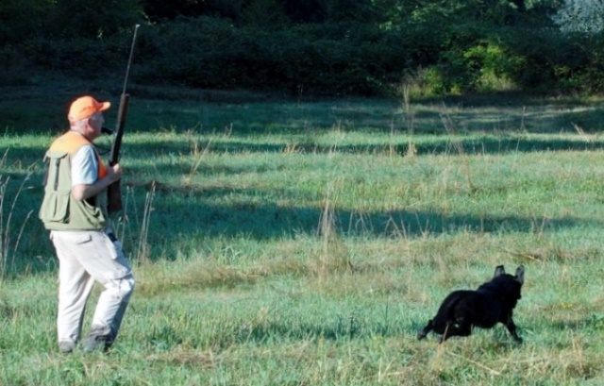
Senior Test Design Considerations: Cont’d
Upland
Dead birds shall be used
The dog shall be required to locate birds as in typical upland hunting
Both dog and handler should maintain gun range
One to three birds must be placed in cover within the test area
Notes:
Discuss the positioning of blinds versus marks at a Senior test.

Slide 12
Evaluating the Senior Dog: General
A retriever’s prime purpose is to get bird to hand as quickly as possible in a pleasing and obedient manner using both natural and trained abilities
Judges must numerically evaluate, each out of 10, the following defined set of abilities against a standard as described in the CKC Rules and Regulations
Marking
Style
Perseverance
Training
These abilities will be NOT be graded in relation to the performance of the other dogs
Scores must be shown to handlers upon request
Notes:
These abilities (Marking, Style, Perseverance, trainability) will NOT be defined in relation to the performance of the other dogs but instead against the standard as set out in the CKC hunt test rules and regulations.
Judges should compare their scores early in the test and throughout the test to see if they are relatively consistent in their numbers.

Slide 13
Evaluating the Senior Dog: General
Trainability, as evidenced in steadiness, control, response and delivery, must be assessed to a greater degree than in Junior
To qualify, an average score of 7 for the whole test (all series) must be achieved and must NOT include a score below 5 in any one ability (Marking, Style, Perseverance, Training)
When a dog is graded “0” by two judges on the same ability, it shall not be called back
A zero score is different from a non-score
A “0” indicates that the dog had an opportunity to exhibit an ability but failed to do so
A “non-score” indicates that an opportunity for the dog to exhibit an ability did not present itself
The ability to mark is of primary importance
Birds located by the dog must be retrieved to hand
Notes:
To qualify, an average of 7 for the whole test must be achieved and must not include an average score below 5 in any one ability. Example: A score of 9 in some categories could fail to qualify if average score in one category is below 5.
Possible Scoring Methods:
Determine whether dog should qualify in that ability category, which might mean an ability score of 5. Knowing the dog must have an overall average of 7, the judge considers whether other abilities deserve a 7 or higher. With a five or less (but not with a zero by both judges), the dog would have to score higher in that ability and other abilities to acquire the 7 overall average.
A judge might want to compare the scores to grades received in school. For example, a 5, 6 or 7 might be comparable to a passing grade of C, an 8 would be a B, etc.
Another method could begin with a perfect score of 10 and progress downward.
Judges should take time to review and check their scores with each other before their scores become final.

Slide 14
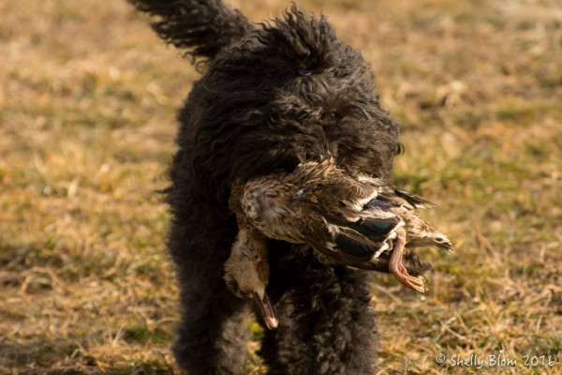
Evaluating the Senior Dog: General Cont’d
It is sufficient cause to grade a dog “0” in marking or perseverance (unless judge feels valid mitigating circumstances exist) if a dog, having been sent to retrieve a mark,
Returns to its handler before finding a bird, with or without having been called in, except when dog is confused as to whether it was really ordered to retrieve;
Stops its hunt; or
Fails to pick the bird up after finding it

Slide 15
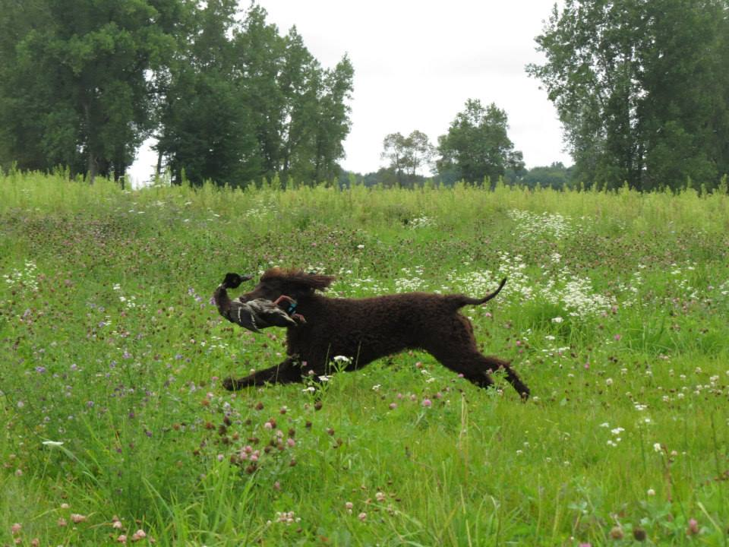
Evaluating the Senior Dog: General Cont’d
Any of the Serious Dog Faults described in section 16.3.1 of the CKC Rules and Regulations can be cause to award a dog “0” in the relevant scoring category
Repeated incidences of moderate and/or minor dog faults in sections 16.4 and 16.5 can also accumulate to be more serious in nature to the point of being non-qualifying
See section on Performance Standards and Fault Classification in this presentation for detail
Notes:
“In marking situations, a handler may give the dog a line in the direction of the fall, provided that such lining is accomplished briskly and precisely. Conspicuously intensive lining suggests a weak marking ability and the dog must be graded low in marking. The handler shall NOT line a dog in the direction of any fall or gun station until all the falls are down.”
- Section 12.6 pg. 46

Slide 16
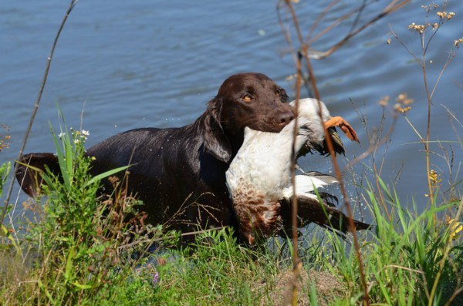
Evaluating the Senior Dog: Talking to the Dog
In Senior, it is desirable that the handlers of both working and honouring dogs remain silent from the time the first shot is fired until the dog is released by the judge
However, the handler may very quietly give an occasional command without incurring a penalty
Talking to the dog in Senior is considered a minor fault

Slide 17
Evaluating the Senior Dog: Recasting the Dog
A Senior dog may be sent to retrieve more than once, but judges must consider this when evaluating marking and perseverance and normally calls for lower grades in these areas
A recast occurs when a dog makes a start toward a marked fall, but stops within a short distance of the line (approx. 5 yards or 4.5 meters) and returns or is recalled to the handler after which the dog is sent to retrieve again
This is often the result of the dog’s confusion as to whether it was sent to retrieve the first time
It is NOT considered a recast when the dog goes to the area of the fall, fails to find the bird or blinks a bird it has found, and returns or is recalled to the handler
This must be regarded as a lack of perseverance and can merit grading the dog “0” in marking or perseverance unless the judges perceive valid mitigating circumstances
Notes:
Discussion should take place at this point by asking the question, “How do you distinguish between a refusal and confusion?”
Factors to consider are:
Did the dog hear the command?
Was the command too loud so as to startle the dog?
Could the conditions that the dog is expected to enter be considered to test their perseverance such as cold or murky water (possibly leading to a refusal)
Discussion and explanation around the statement as quoted below could take place. What if a judge assigns “0” in BOTH marking AND perseverance under these circumstances?
“This must be regarded as a lack of perseverance and can merit grading the dog “0” in marking or perseverance unless the judges perceive valid mitigating circumstances”
- Marking OR perseverance.

Slide 18
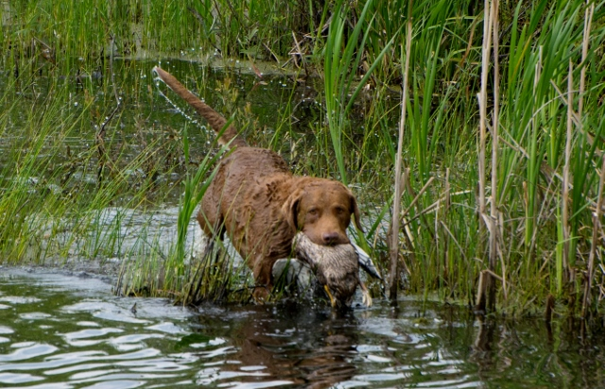
Evaluating the Senior Dog: Handling on Marks
Perseverance should be encouraged on marked retrieves, however, dogs may be handled on marks
Excessive handling requires a lower score in perseverance
A dog which proceeds to the area of the fall and finds the bird on its own should be scored appreciably higher than a dog that must be handled to a bird

Slide 19
Evaluating the Senior Dog: Steadiness
The Senior dog is to work off leash from the time it leaves the holding blind until it is behind the judges at the completion of the series
Handlers must not pull out leashes or other training devices until behind the judges
Dogs should be steady on the line for marks and for the honour
The handler may not hold or touch a dog to keep it steady; this is a serious handler fault which can merit elimination
A controlled break is allowed in Senior; it is considered a moderate fault
Creeping is categorized as a minor dog fault
Notes:
Discussion should take place at this point by asking the question, “How do you distinguish between a refusal and confusion?”
Factors to consider are:
Did the dog hear the command?
Was the command too loud so as to startle the dog?
Could the conditions that the dog is expected to enter be considered to test their perseverance such as cold or murky water (possibly leading to refusal)

Slide 20
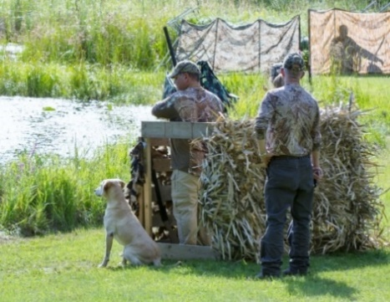
Evaluating the Senior Dog: Steadiness Cont’d
Greater leeway on steadiness is to be granted to the Senior dog in its trainability score than a Master dog
Conversely, a controlled break or creeping should result in a relatively lower score in trainability than it would in a Junior test
A controlled break on the honour must not interfere with the working dog

Slide 21
Evaluating the Senior Dog: Interference
In the case of another dog breaking for the same fall as the working dog and interfering with the working dog that in any way causes a faulty performance, the working dog should be considered as not having been tested and given another opportunity to be evaluated
If the handler of an honouring dog makes a noise or command which might interfere with the working dog, the judges have the discretion to remove the offending team from the test

Slide 22
Evaluating the Senior Dog: Switching
A dog is considered to have switched if it:
Goes to the area of a fall, hunts, fails to find the bird and then leaves the area to hunt for another fall; or
Drops a bird it is retrieving and goes for another bird
Unless the judges agree that valid mitigating circumstances exist, a dog that switches shall be scored “0” in perseverance and eliminated
It should NOT be considered a switch, and therefore lack of perseverance, if the dog:
Finds another bird on the way to one fall and retrieves it first, or
Changes direction on the way out to one fall, does not establish a hunt and retrieves another bird

Slide 23
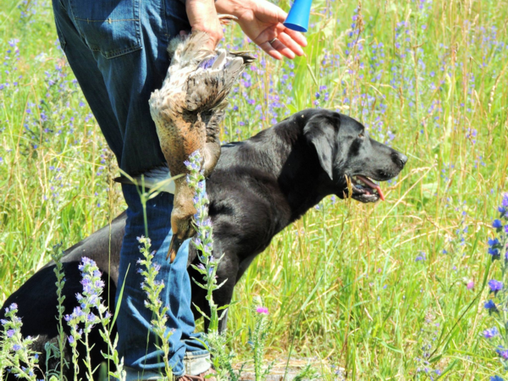
Evaluating the Senior Dog: Lining the Dog
In marking situations, the handler should not line a dog with his or her hand in the direction of any fall or gun station until all falls are down
A handler may give the dog a line in the direction of the fall, provided that such lining is accomplished briskly and precisely
Conspicuously intensive lining with the hand suggests a weak marking ability and the dog must be graded low in marking
Notes:
“In marking situations, a handler may give the dog a line in the direction of the fall, provided that such lining is accomplished briskly and precisely. Conspicuously intensive lining suggests a weak marking ability and the dog must be graded low in marking. The handler shall NOT line a dog in the direction of any fall or gun station until all the falls are down.”
- Section 12.6 pg. 46

Slide 24
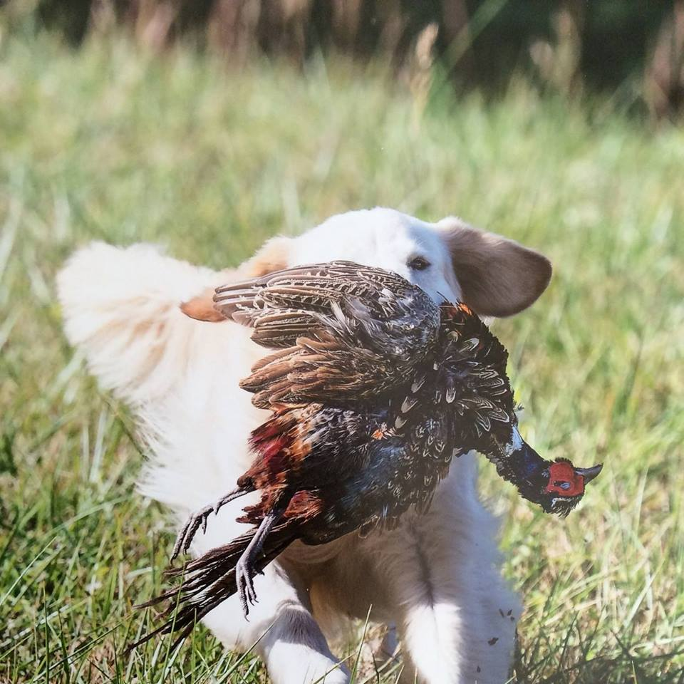
Evaluating the Senior Dog: Upland
The dog shall be required to locate birds as in typical upland hunting and within gun range of the handler
The dog may be urged to hunt or be handled to maintain his range and position
When located, the birds must be retrieved by the dog to hand

Slide 25
Evaluating the Senior Dog: Hard Mouth
Hard mouth is one of the most undesirable traits in a retriever
A dog can carry the stigma for life and therefore hard mouth requires incontrovertible proof
Torn skin or flesh alone is not usually sufficient evidence for proof as it may be caused in a variety of ways, such as by sharp sticks or stones, etc. in the cover as well as by the dog’s fast, positive pick-up
Crushed bone structure can usually be accepted as trustworthy and sufficient evidence of hard mouth

Slide 26
Evaluating the Senior Dog: Hard Mouth Cont’d
Other undesirable traits are frequently confused with hard mouth such as freezing with bird in mouth
A hard mouthed dog may still have a gentle delivery and a reluctant or sticky delivery does NOT imply hard mouth
Rolling or mouthing the bird during a retrieve may be erroneously associated with hard mouth as well even when the bird is not damaged
Such mouthing may not necessarily call for a lowering of a trainability score
The judge should remember a dog either does or does not have a hard mouth, and if it does, cannot receive a qualifying score

Slide 27
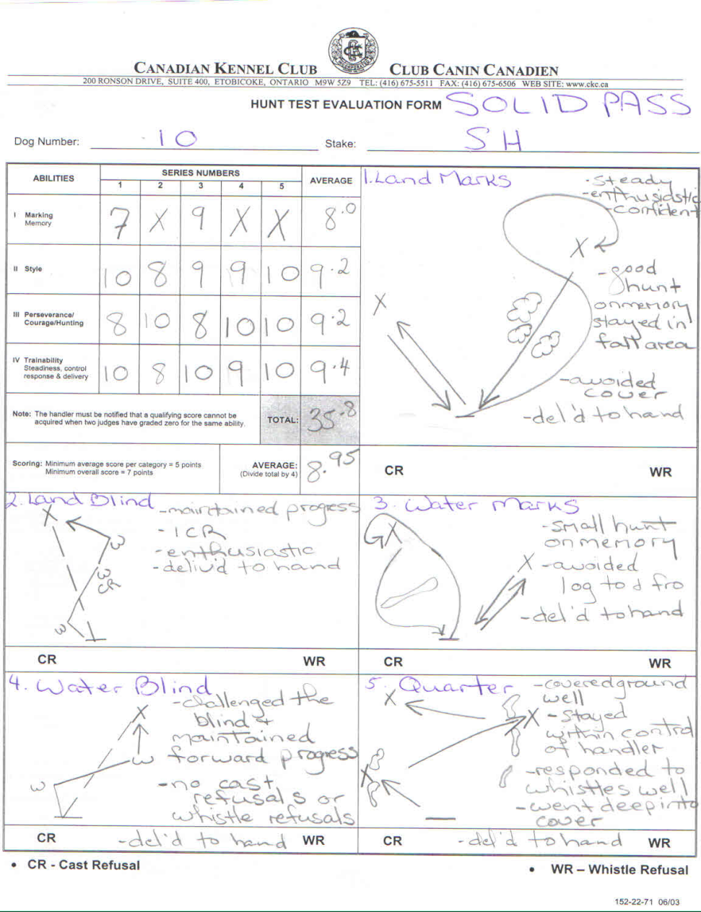
Evaluating the Senior Dog: Sample Score Sheet
Notes:
Senior Test usually consists of the following: One land blind, One water blind, One set of double land marks, One set of double water marks, an Upland hunting test in which the dog shall locate birds as in a typical upland hunting situation, maintaining gun range with the handler
To qualify, an average score of 7 for the whole test (all series) must be achieved and must NOT include an average score below 5 in any one ability (Marking, Style, Perseverance, Trainability)
Possible Scoring Methods:
Determine whether dog should qualify in that ability category, which might mean an ability score of 5. Knowing the dog must have an overall average of 7, the judge considers whether other abilities deserve a 7 or higher. With a five or less (but not with a zero by both judges), the dog would have to score higher in that ability and other abilities to acquire the 7 overall average.
A judge might want to compare the scores to grades received in school. For example, a 5, 6 or 7 might be comparable to a passing grade of C, an 8 would be a B, etc.
Another method could begin with a perfect score of 10 and progress downward.
Judges should take time to review and check their scores with each other before their scores become final.
The score sheet sample above represents a SOLID PASS.

Slide 28
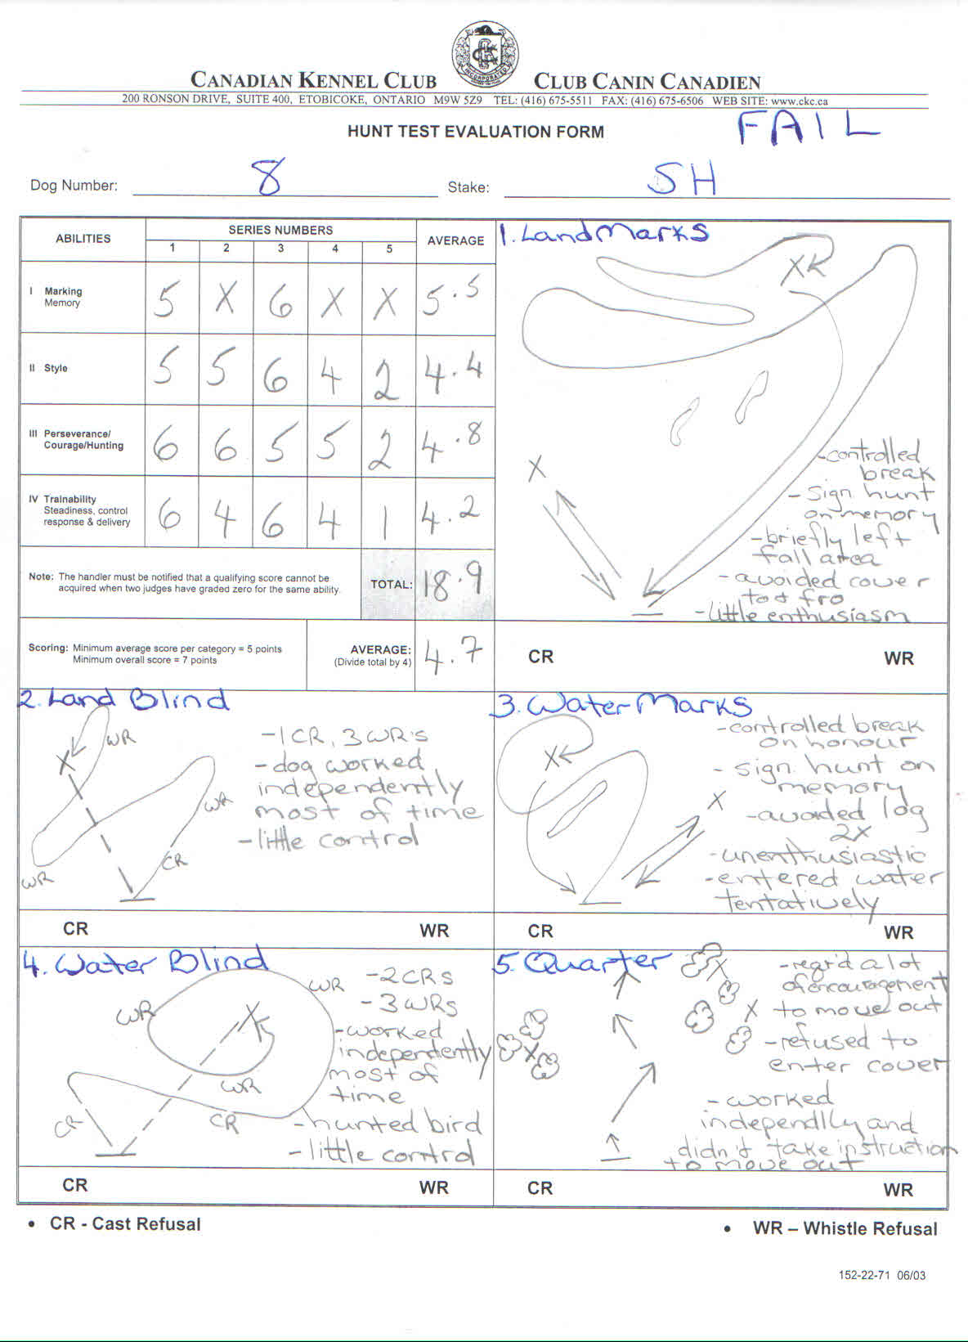
Evaluating the Senior Dog: Sample Score Sheet
Notes:
Senior Test usually consists of the following: One land blind, One water blind, One set of double land marks, One set of double water marks, an Upland hunting test in which the dog shall locate birds as in a typical upland hunting situation, maintaining gun range with the handler
To qualify, an average score of 7 for the whole test (all series) must be achieved and must NOT include an average score below 5 in any one ability (Marking, Style, Perseverance, Trainability)
Possible Scoring Methods:
Determine whether dog should qualify in that ability category, which might mean an ability score of 5. Knowing the dog must have an overall average of 7, the judge considers whether other abilities deserve a 7 or higher. With a five or less (but not with a zero by both judges), the dog would have to score higher in that ability and other abilities to acquire the 7 overall average.
A judge might want to compare the scores to grades received in school. For example, a 5, 6 or 7 might be comparable to a passing grade of C, an 8 would be a B, etc.
Another method could begin with a perfect score of 10 and progress downward.
Judges should take time to review and check their scores with each other before their scores become final.
The score sheet sample above represents a SOLID PASS.

Slide 29
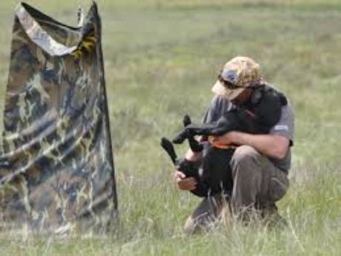
Perhaps Above All
Hunt tests should be an enjoyable sport in which handlers and their dogs get to work as a team and have fun
Thank you!

